Slide 1
OOAD Project:
Chatroom Application
By:
Rima Modak (00001650730)
Prachi Mahesh Mokashi (00001652374)
Aishwarya Subhlok (00001641458)

Slide 2
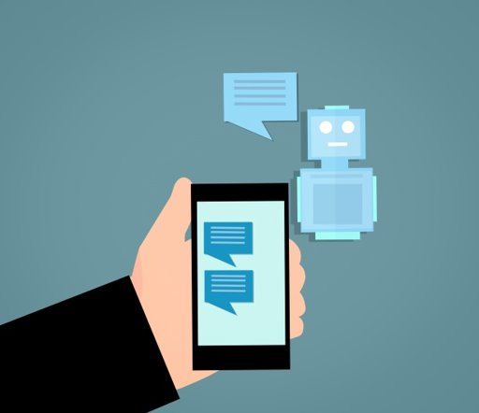
INTRODUCTION
A client-server model - defined as the relationship between two computer programs that communicates with each other.
Client-server model also is a distributed application structure that partitions tasks or workloads between the providers of a resource or service, called servers, and service requesters, called clients.
The clients initiate the communication by sending service requests to servers.
This project is developed using socket programing and multi-threading using JAVA programing.
The goal of this chatting application is it enables us to stay in connected anytime, anywhere from any part of the world.
This instant messaging is the exchange of real-time messages through a stand-alone application or an embedded software.

Slide 3
PROBLEM STATEMENT
This project is to create a chat application with a server and users to
enable the users to chat with each other.
The application supports following functionalities -
● User register/login to a chat room
● User should be able to join a room
● The homepage should display all the available/online users.
● User can logout from a chat room
● Design and implement a user interface to achieve all the above-mentioned functionalities

Slide 4
REQUIREMENT ANALYSIS
Admin should be able to create a chat room system should list all the online and offline users
User can choose any other registered user to chat.
There are 3 different category of message :
    Unicast
    Multicast
    Broadcast
Chat application has multiple clients/users.
Chat application has users with unique names
Chat application allows all users to post contents .
Chat application has an admin and only admin can create the chat room.

Slide 5
ASSUMPTION
Chat application has multiple clients/users.
Chat application has users with unique names.
Chat application allows all users to post contents.
Chat application has an admin and only admin can create the chat room.
Users can communicate only with other the users of same chat room

Slide 6
USE CASES
Here are the main Actors in our system:
Admin: Mainly responsible for creating chat room for multiple clients/users to communicate.
Client: All clients/users can send/receive messages if they are part of chat room and are online.
Here are the top use cases for Chatroom Application:
Chatroom Creation: Admin creates the chatroom.
Register/login user: Add user to the admin created chatroom.
Message Send/ Receive: Multiple users of same chatroom can communicate between each-other.
Room Deletion: Once the server gets logged out, chatroom gets deleted.

Slide 7
PROCESS
Client - connect to the server and once they have connected to each other, the client will be able the receive input from the user and sent it to the server
Server then receive the input from the client and start to process data to give back the output to the client and display it to the user.
For our project, the server will do to process which are to calculate the number of bytes of the message written by the user and the elapsed time of the connection.
In the client part, it will display the normal chatting interface that enable the client to communicate with the server.

Slide 8
OBJECT ORIENTED CONCEPTS AND DESIGN PATTERNS
ALL MAIN PILLARS:
ENCAPSULATION
INHERITANCE
OTHERS
    ITERATORS
    VECTORS
    MULTI-THREADING
ChatServer = Singleton
ChatClient = Inheritance

Slide 9
CLASS DETAILS
ServerScreen - This class initializes the server socket with the port number. It is used to accept the connection request from multiple clients. Additionally this class builds a frame which displays online users' information in a chat room. This class is also responsible to handle multiple client threads.
ClientScreen - This class is for Client Screen. It asks the user to submit their name and uses that to identify the client. The server is presumptively running at same port on the same machine (localhost). Go to a different command prompt and run client once for each user.
User - To hold all user objects, including retrieve and set usernames, timestamps, and user status is being done from User Model class. The name that a person enters while signing up for a chatroom application is saved as their username. User status indicates whether user is online or offline. Timestamps keep track of when a user last signed in.
CSVReaderInJava - This class keeps track of login users in a designated CSV file. It is capable of creating, reading from, and updating a specific CSV file that is located at a given location in a certain directory.

Slide 10
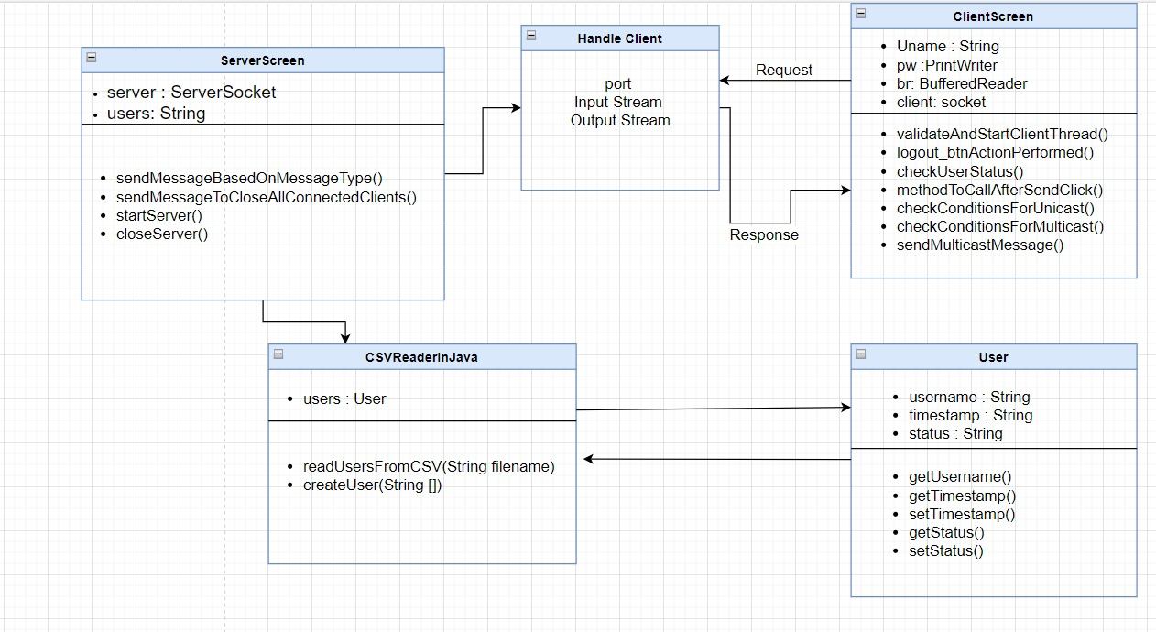
CLASS DIAGRAM

Slide 11
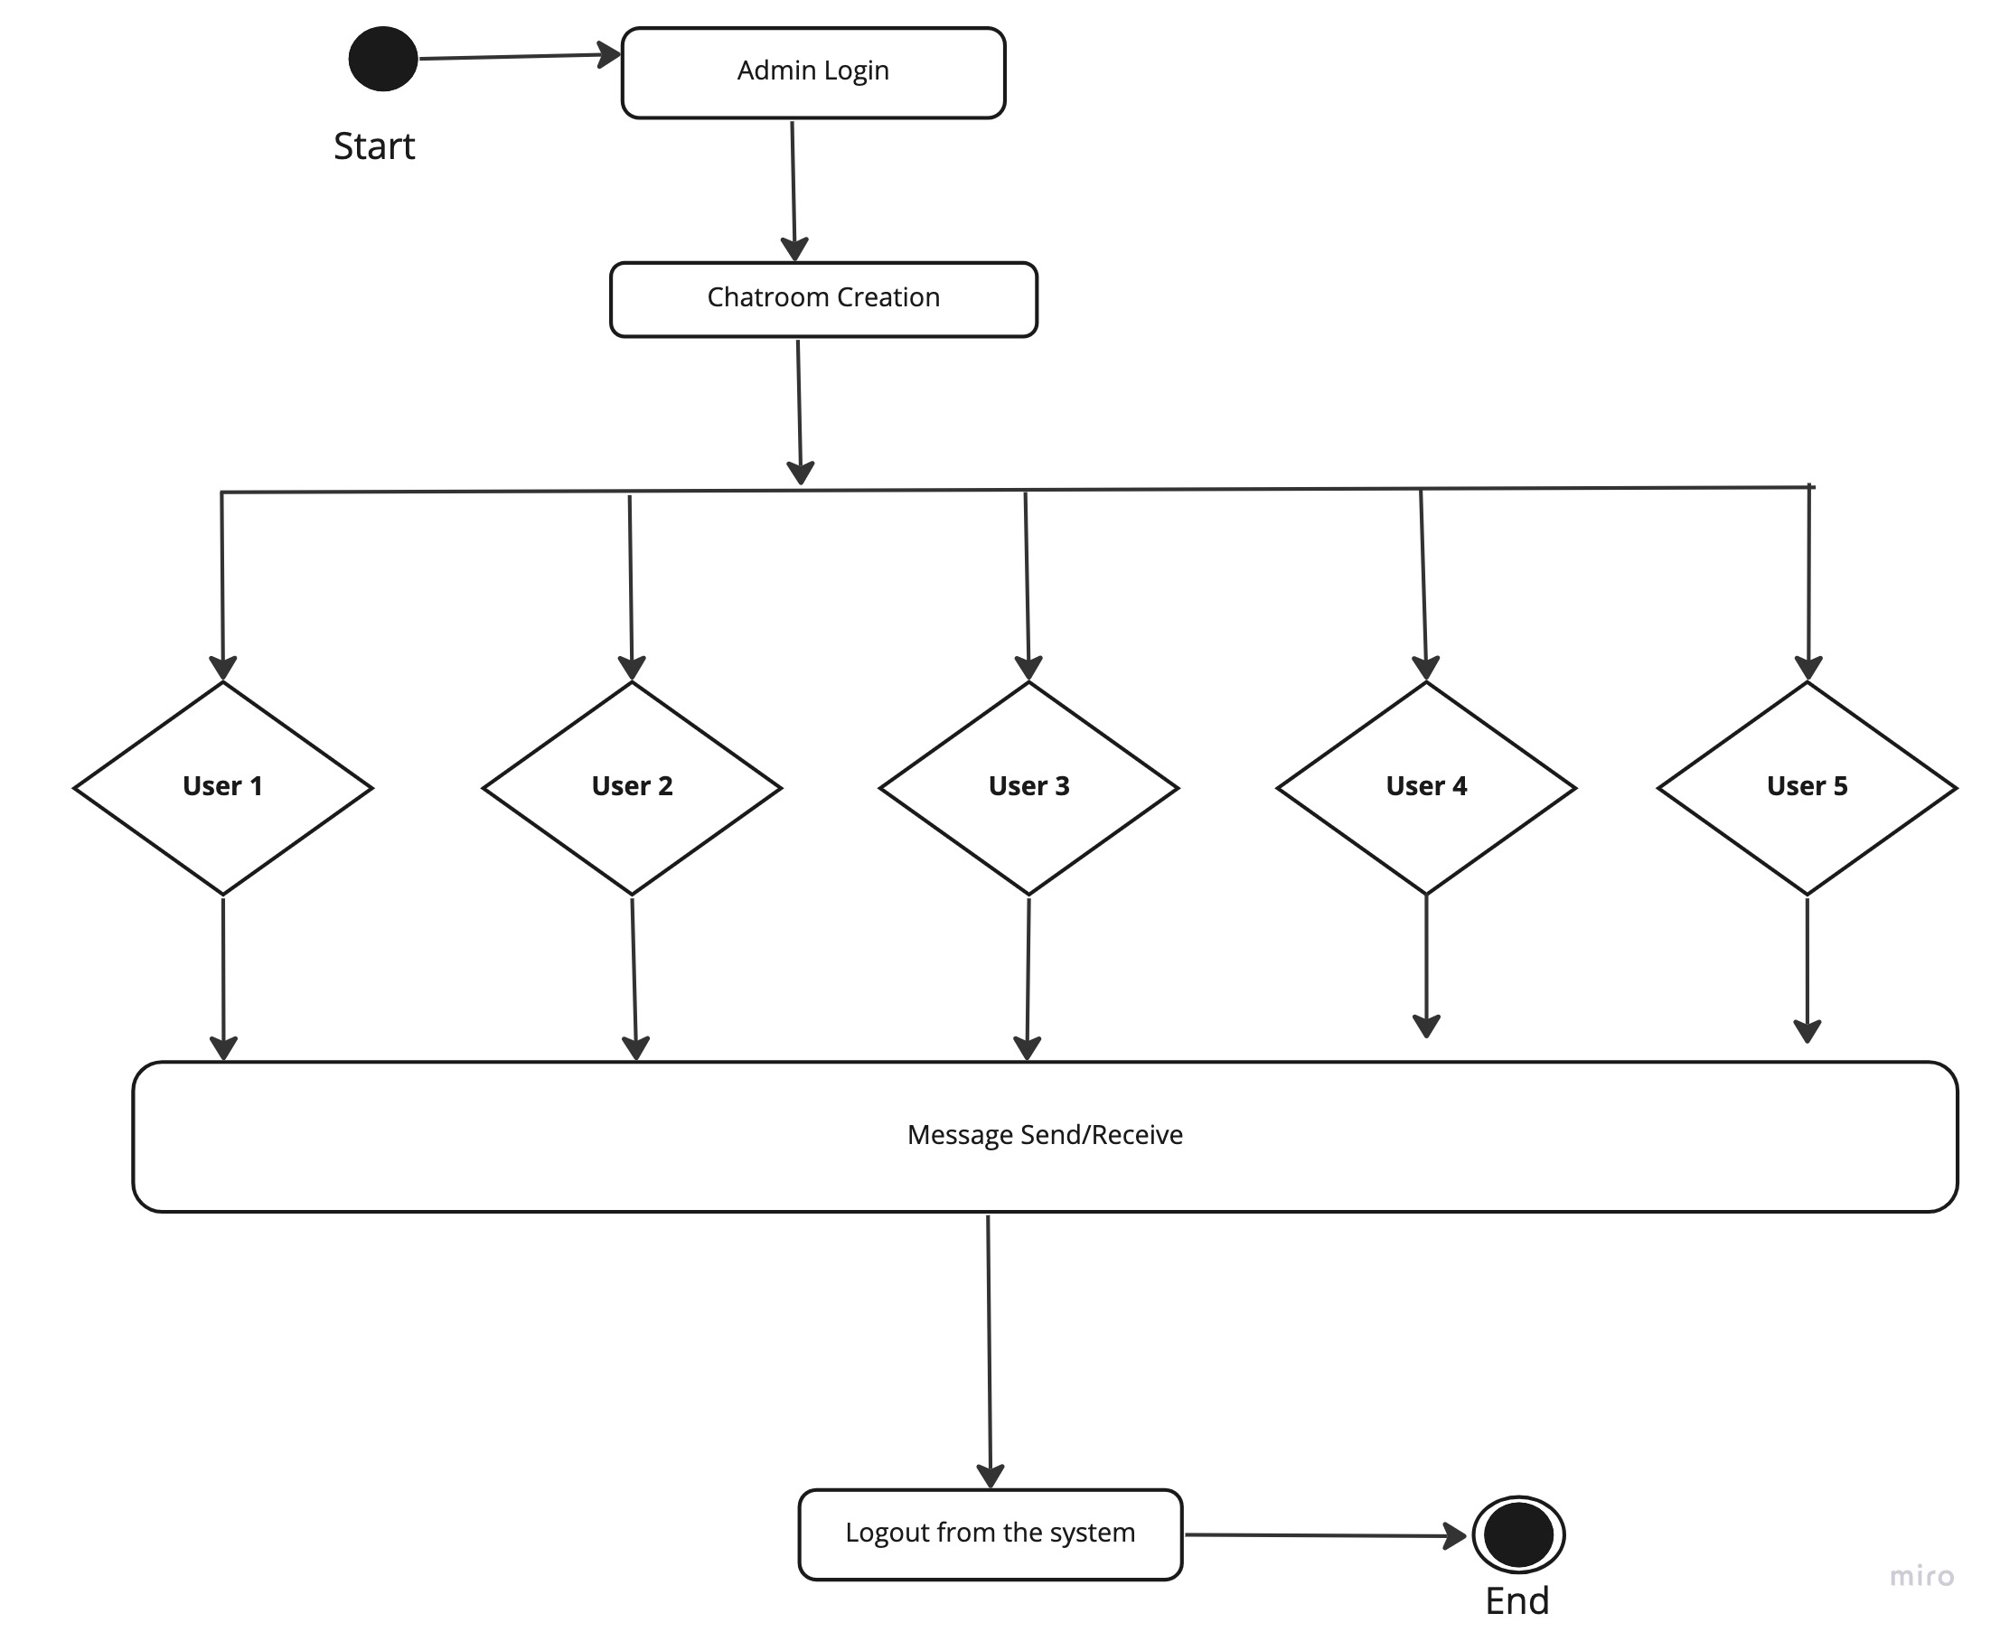
ACTIVITY DIAGRAM

Slide 12
USE-CASE MODEL
Use-cases model the system from the end-user's point of view. Created during requirements elicitation.
Use-cases should achieve the following objectives:
To define the functional and operational requirements of the system (product) by defining a scenario of usage that is agreed upon by the end-user and the software engineering team.
To provide a clear and unambiguous description of how the end-user and the system interact with one another
To provide a basis for validation testing.
During OOAD, use-cases serve as the basis for the first element of the analysis model. Using UML
notation, a diagrammatic representation of a use-case, called a use-case diagram, can be created. Like many elements of the analysis model, the use-case diagram can be represented at many levels of abstraction. The use-case diagram contains actors and use-cases. Actors are entities that interact with the system.

Slide 13
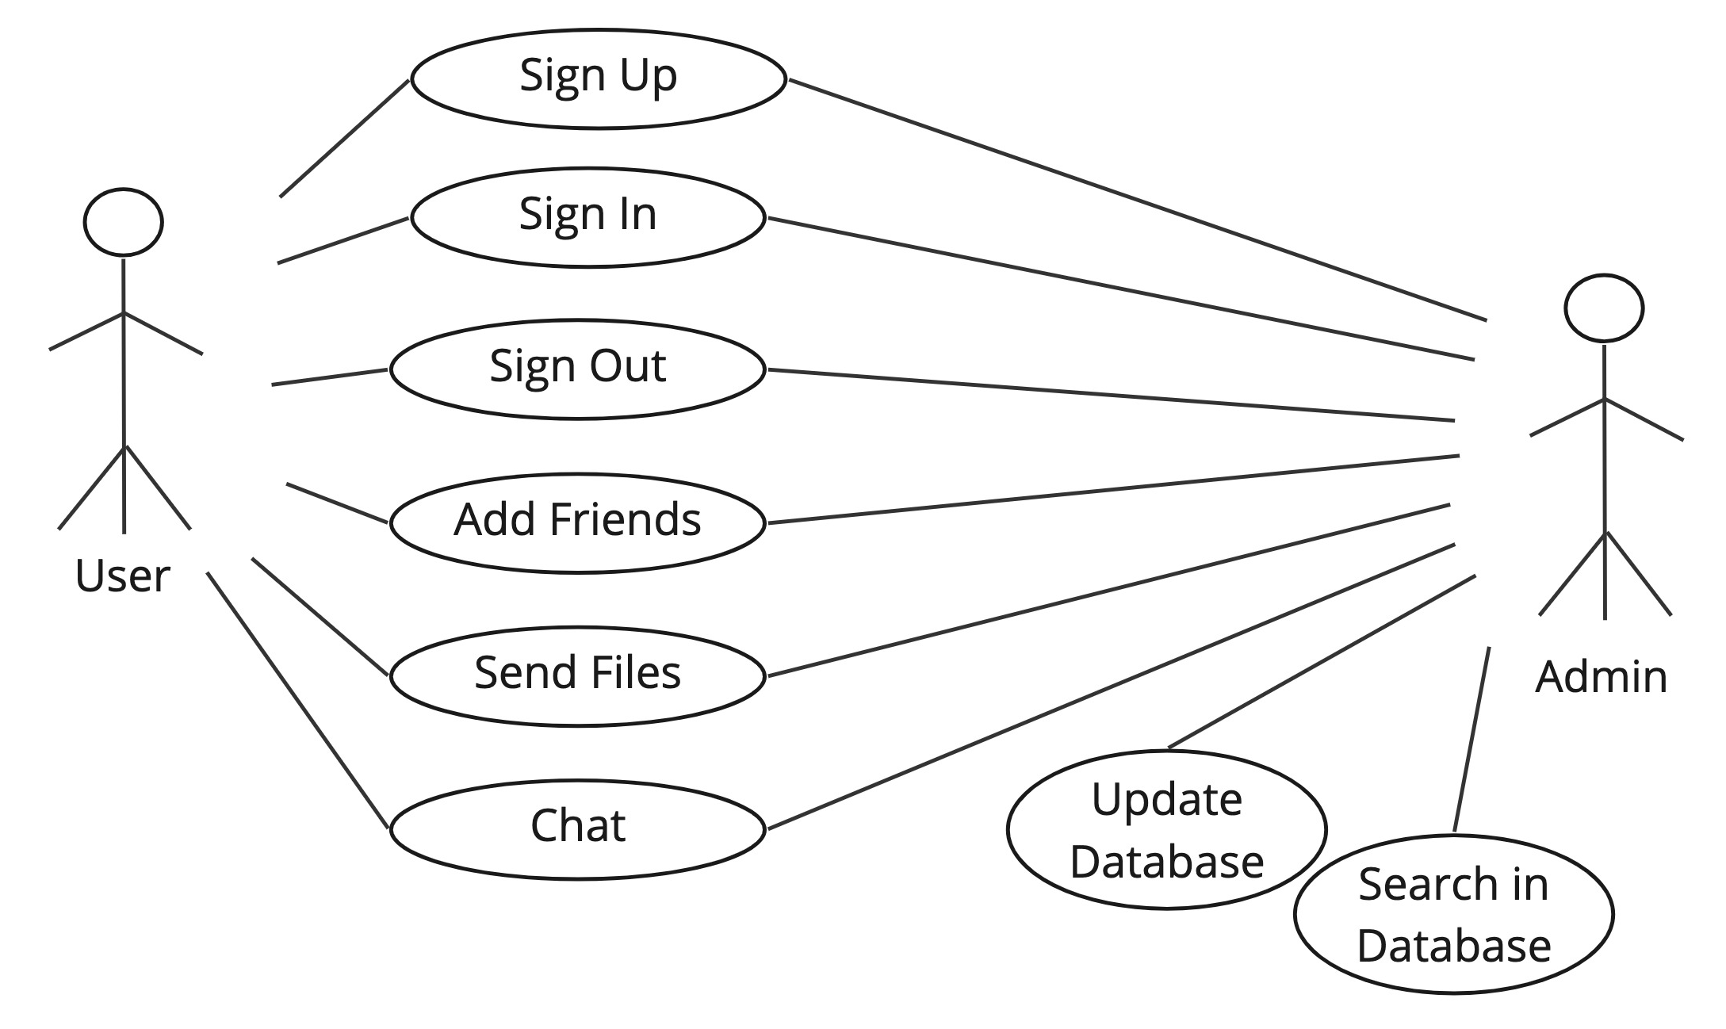
Use Case Diagram

Slide 14
UML SEQUENCE DIAGRAM
UML sequence diagrams are used to show how objects interact in a given situation.
An important characteristic of a sequence diagram is that time passes from top to bottom:
The interaction starts near the top of the diagram and ends at the bottom
Sequence diagrams contain the same information as Collaboration diagrams but emphasize the sequence of the messages instead of the relationships between the objects.
Sequence diagram for voice chat system:
Client send the request to connect as button connect action performed.
Server accepts the request, validate it and create the chat handler for client requested the connection.
Server continues listening on the port for new client requesting for connection.
Now client writes the text data or voice data to chat handler which broadcast the accepted data.
All clients accept the data and perform the necessary action, then client and chat handler are destroyed as their work is done.

Slide 15
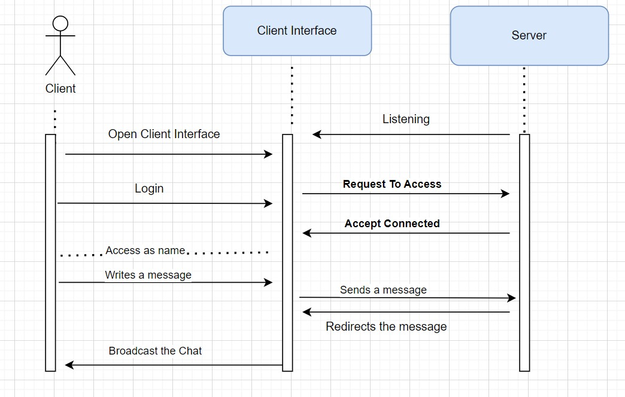
SEQUENCE DIAGRAM FOR CHAT TASK

Slide 16
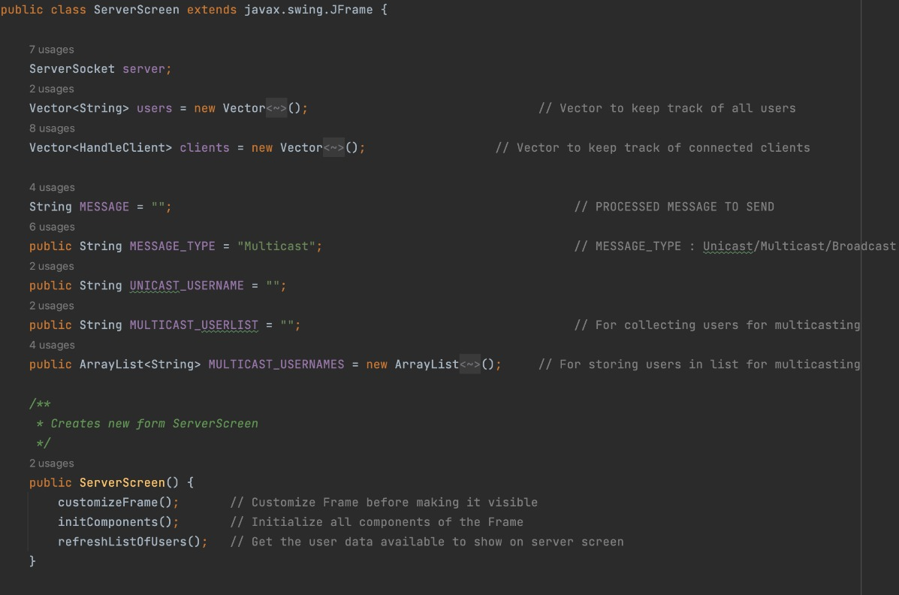
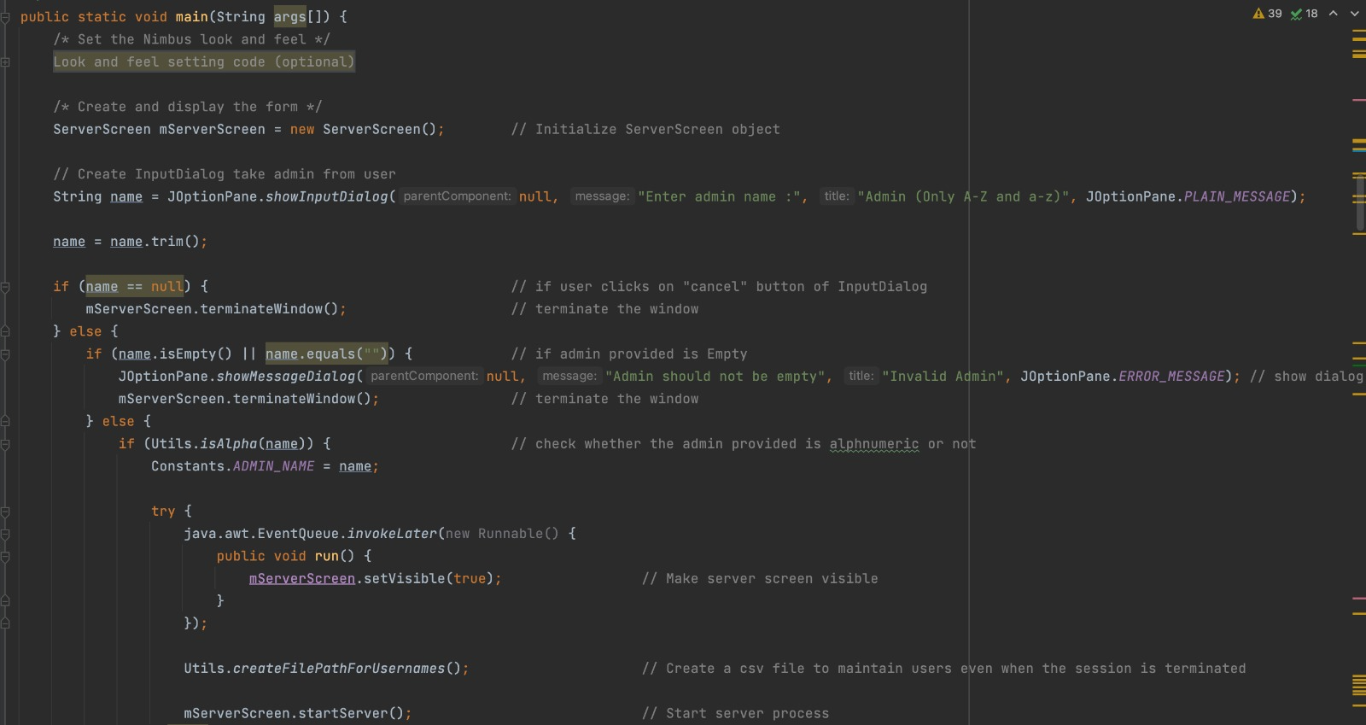
SERVER SIDE CODE

Slide 17
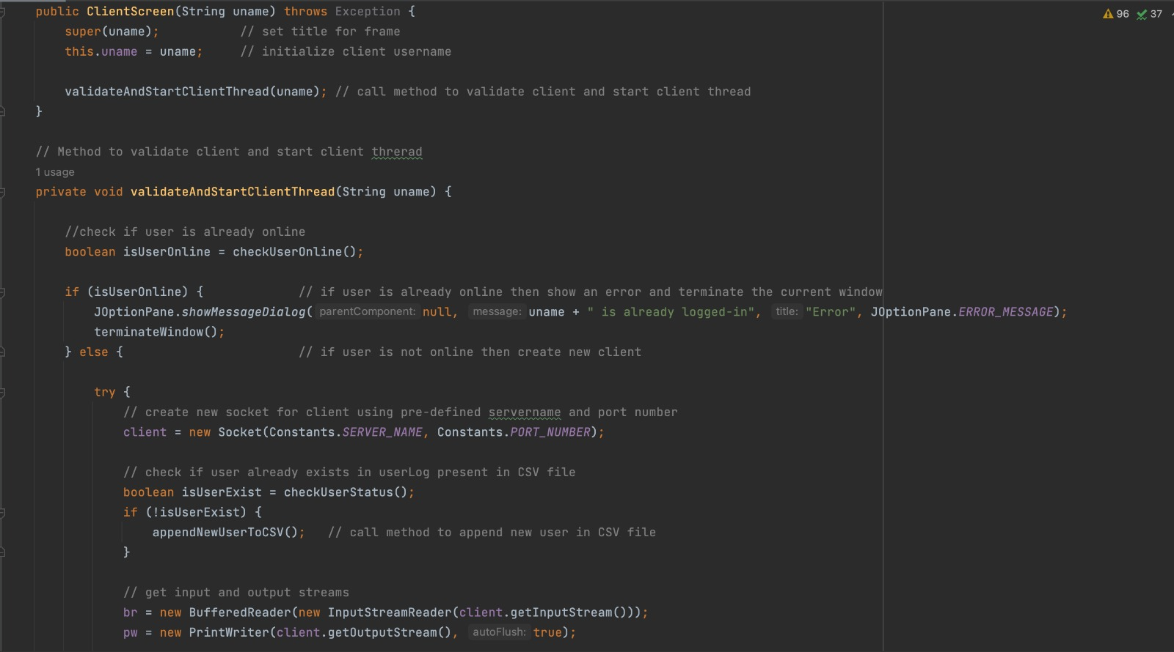
CLIENT SIDE CODE

Slide 18
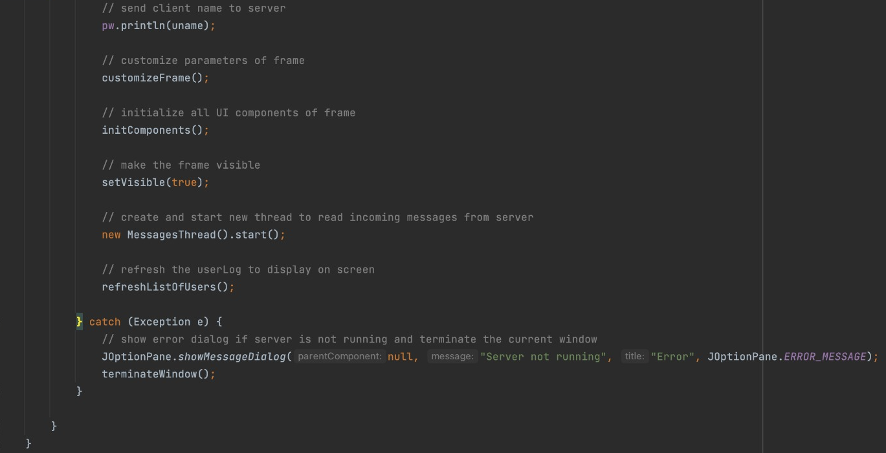
CLIENT SIDE CODE Conti''

Slide 19
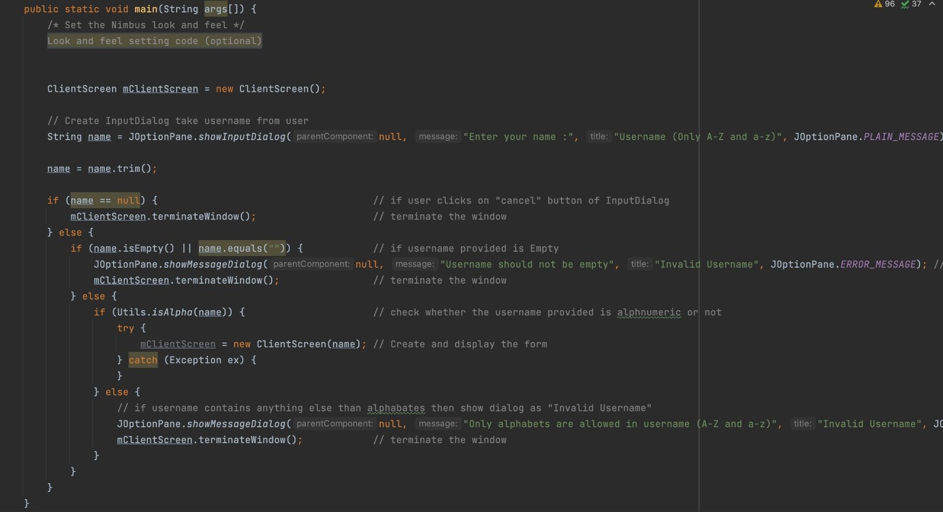
CLIENT SIDE CODE Conti''

Slide 20
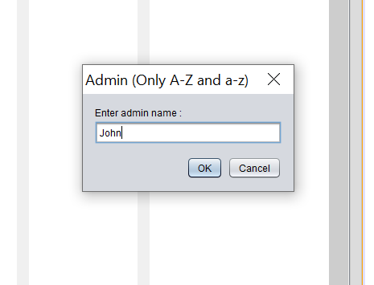
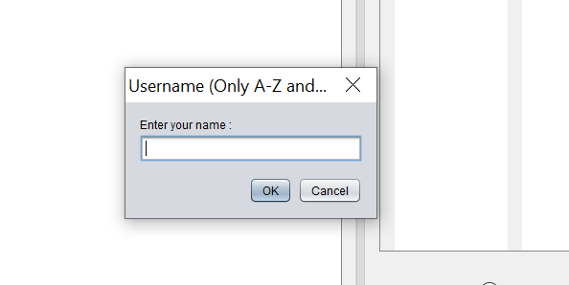
OUTPUT

Slide 21
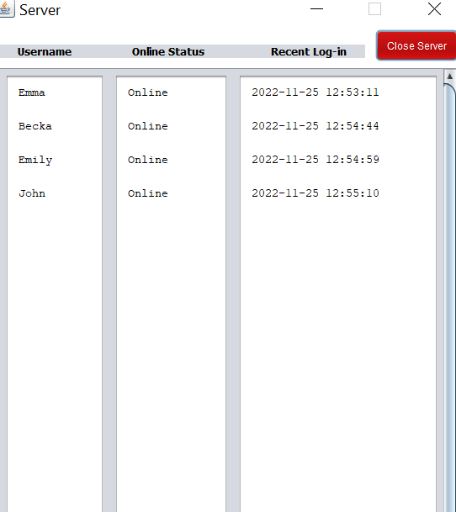
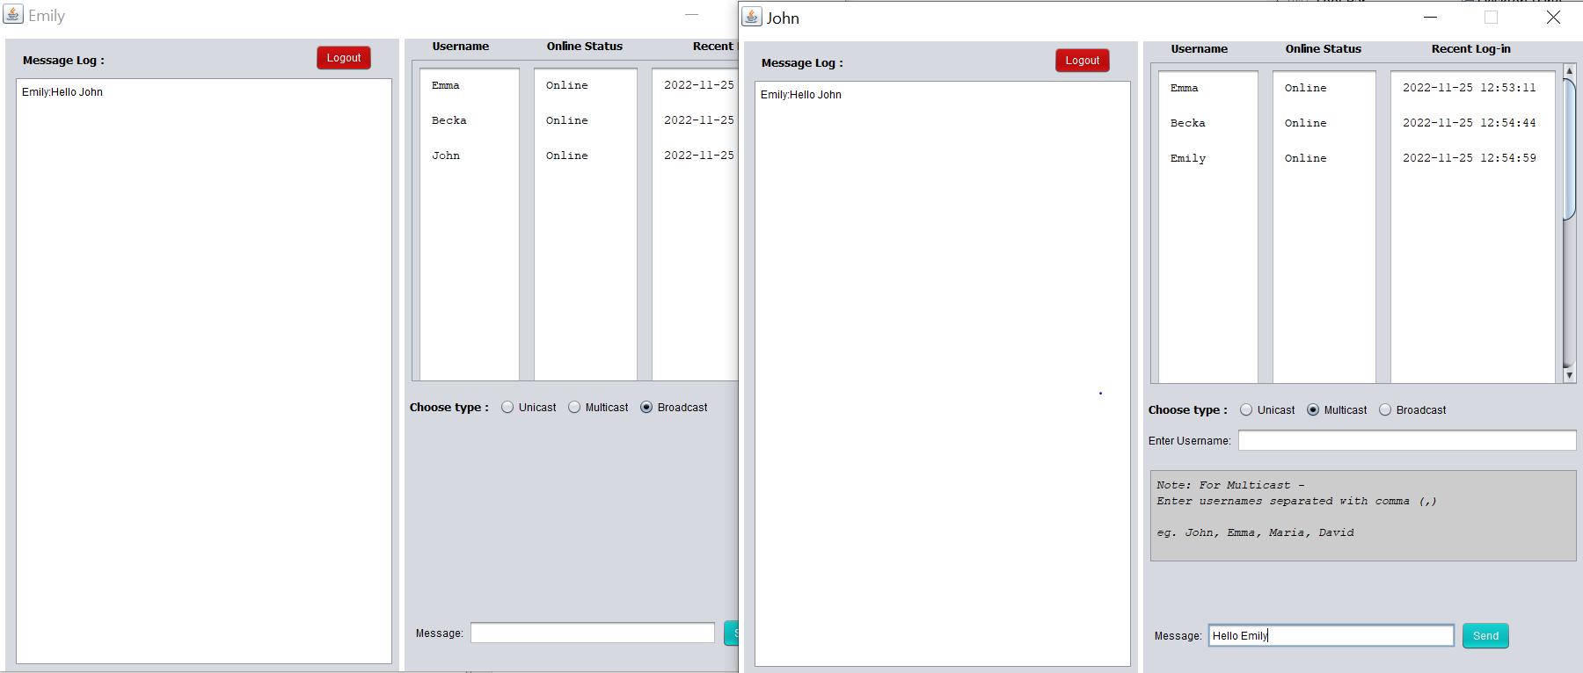
OUTPUTN Conti''

Slide 22
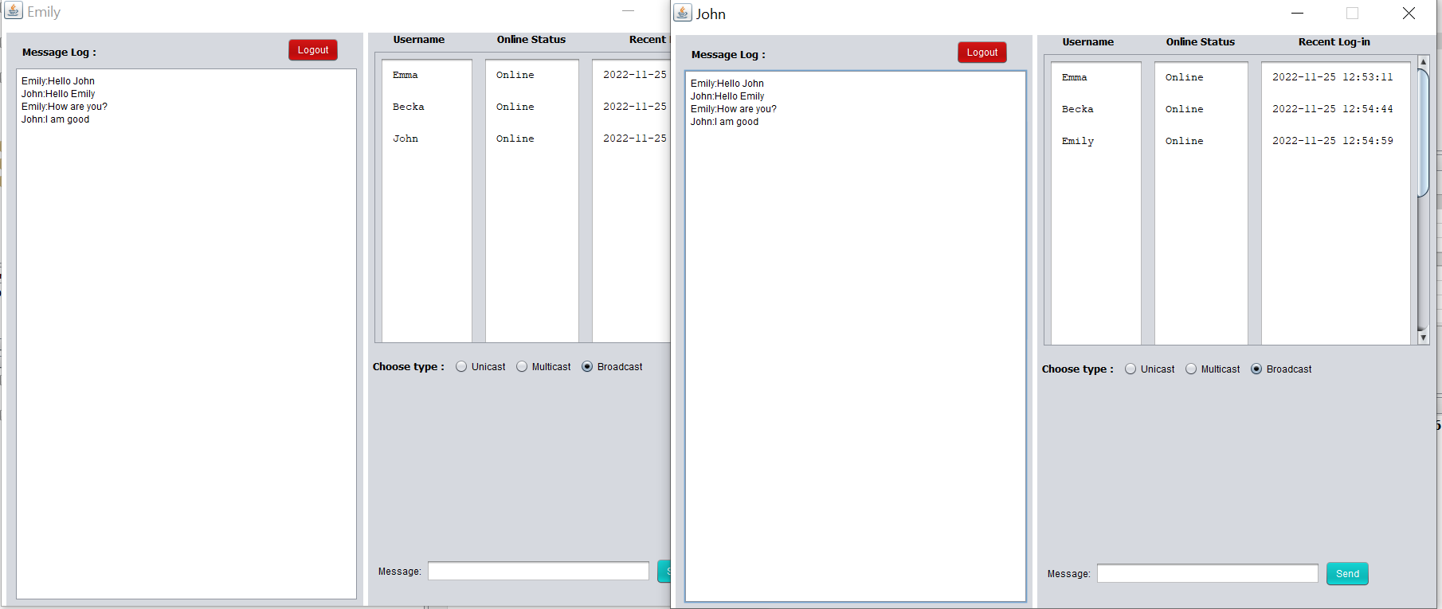
OUTPUTN Conti''

Slide 23
TECHNOLOGY USED
Programing language: JAVA Program
Framework: J-frame
IDE: NetBeans
Others:
    Multi-Threading
    Socket programming

Slide 24
CONCLUSION
The Client-Server network model usually consists of one or more server computers that provide services and information to several workstation computers.
In our project, we have managed to develop a chatting application system for this course using a client-server model.
We have successfully solved our objectives which is to be able to communicate and exchange of real-time messages at anytime and anywhere

Slide 25


